Slide 1
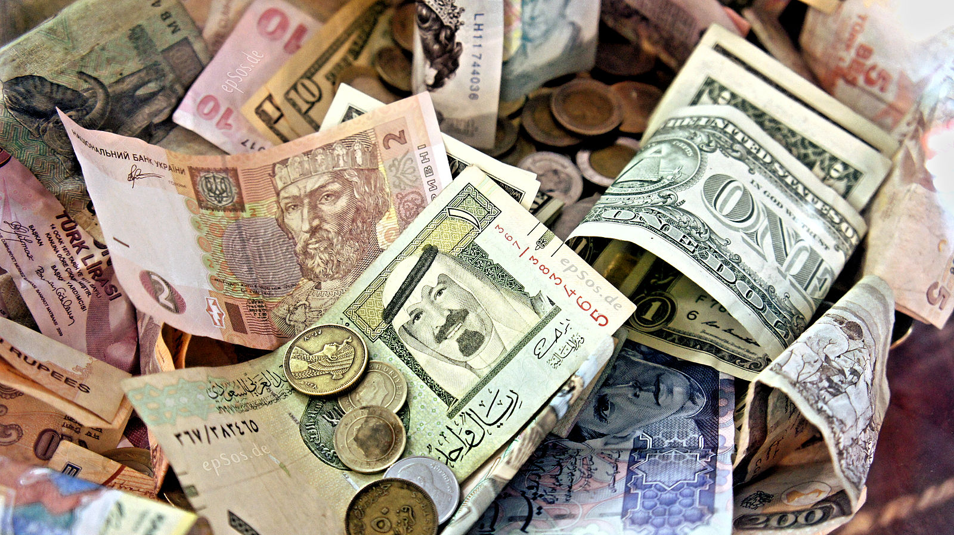
Class 16:
Alternate Cryptocurrencies
Cryptocurrency Café
UVa cs4501 Spring 2015
David Evans
flickr cc: epSos.de

Slide 2
Plan
Project 2
Final Project
Proposals due Thursday
Alternatives to Bitcoin
Memory-hardness
Useful proofs of work?

Slide 3

Estimating Mining Cost
90 days
$8,161.10
$7,521,228
374362.67 years
$0.000087
$0.00036
$0.148
$0.00037
$0.
$0.0022

Slide 4
“Given the fact that I’ve just found a block, I suspect that something went amiss in my calculation here.”

Slide 5
Joseph Weate’s answer:
Using the output log of my miner.go, I can see that my code produces (on average), 1.5 million hashes in 5 seconds. This results in a hashing rate of 300,000 hashes/sec. With the current difficulty at 310 million, this would take my code 17.2 minutes to find a block. A block has the value of 10 pointcoins. Thus it takes 1.7 minutes (about 100 seconds) to mine 1 pointcoin. The cost for an amazon EC2 - t2.micro node, the cost is 1.3 cents per hour. This would mean that the cost to mine 1 pointcoin costs 0.036 cents ($0.00036).
Going off the "value" of pointcoin ->based off a pizza transaction. 150 pointcoins has the value of a $22.27 pizza from papa johns. This would create an individual pointcoin to be worth 14.8 cents.
Mining is worth it.

Slide 6
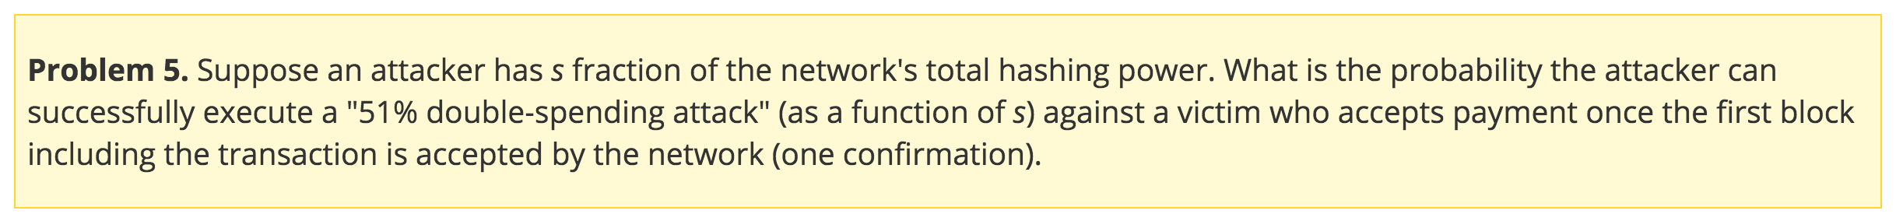

Slide 7
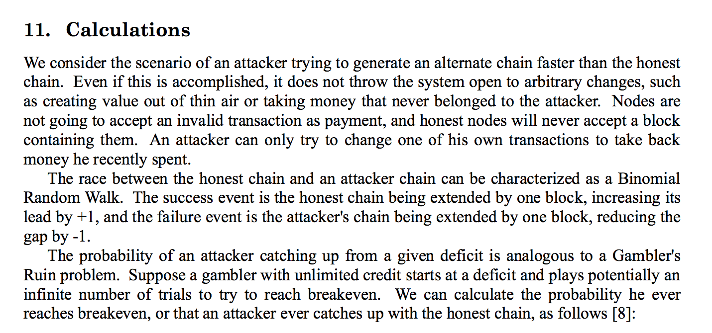

Slide 8
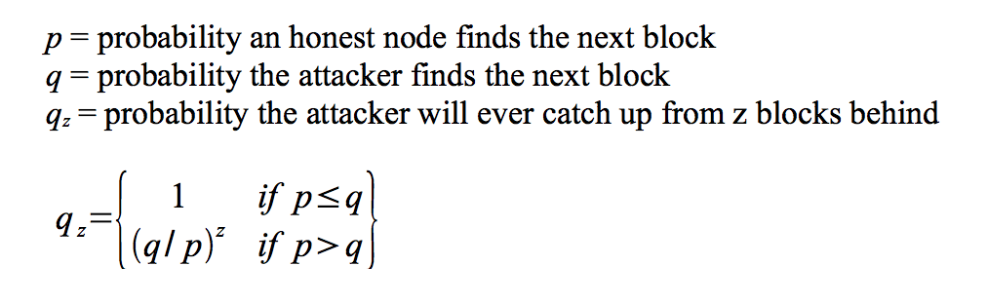

Slide 9
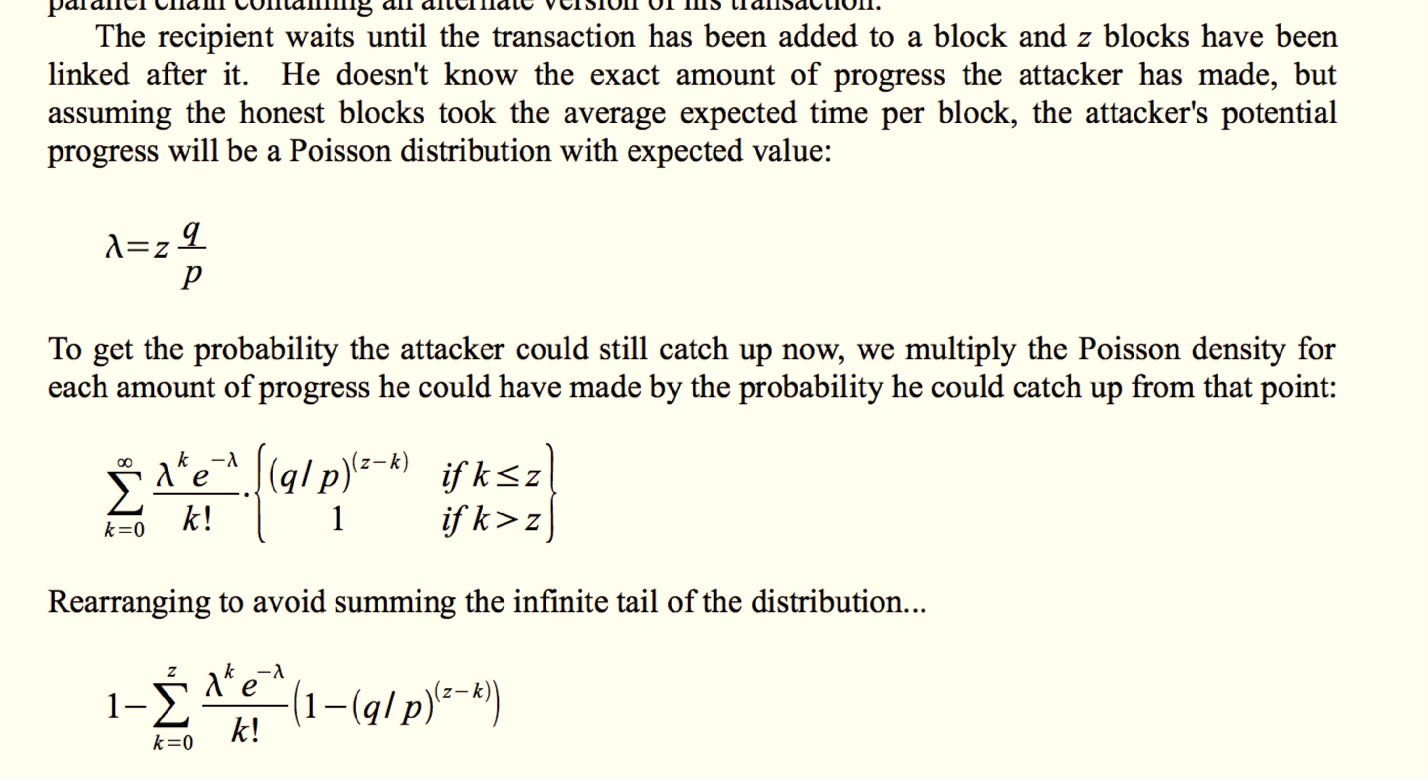

Slide 10
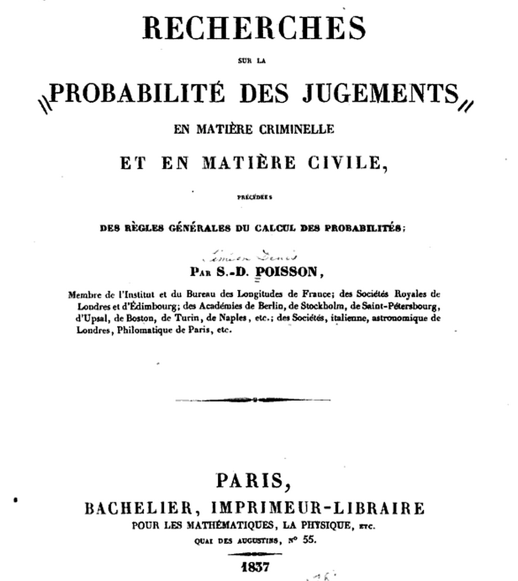
Pr(number of occurrences = k)
= λ^{k}e^{-λ} / k!

Slide 12
Final Project
Other than possible quizzes and readings questions, this is the last assignment (with several deliverables).
Project Proposals
Due: Thursday (March 19)
Presentations about project ideas: April 1
First deliverable: April 5
Final presentations + reports: end of semester

Slide 13
Project Proposals
Title of your Proposal - a short title that should get across what you are doing.
Team members list - a list of everyone on your team. You should `cc:` all the team members in the email so I have one email to reply-all to that will reach your full tem.
Motivation - explanation of why your project topic is worthwhile.
Project Plan - what you plan to do.
First deliverable - description of what you will have ready to submit for the first deadline, Sunday, 5 April (note that you will be presenting about your project in class on Wednesday, 1 April).

Slide 14
Alternate Cryptocurrencies

Slide 15
Currency

Slide 16
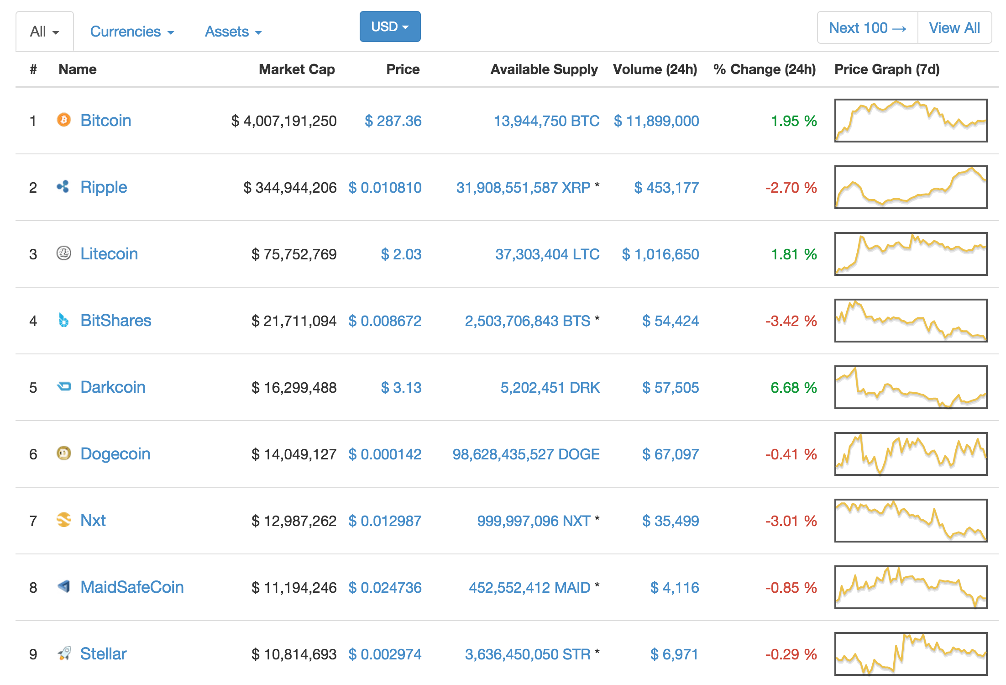
http://coinmarketcap.com/

Slide 17
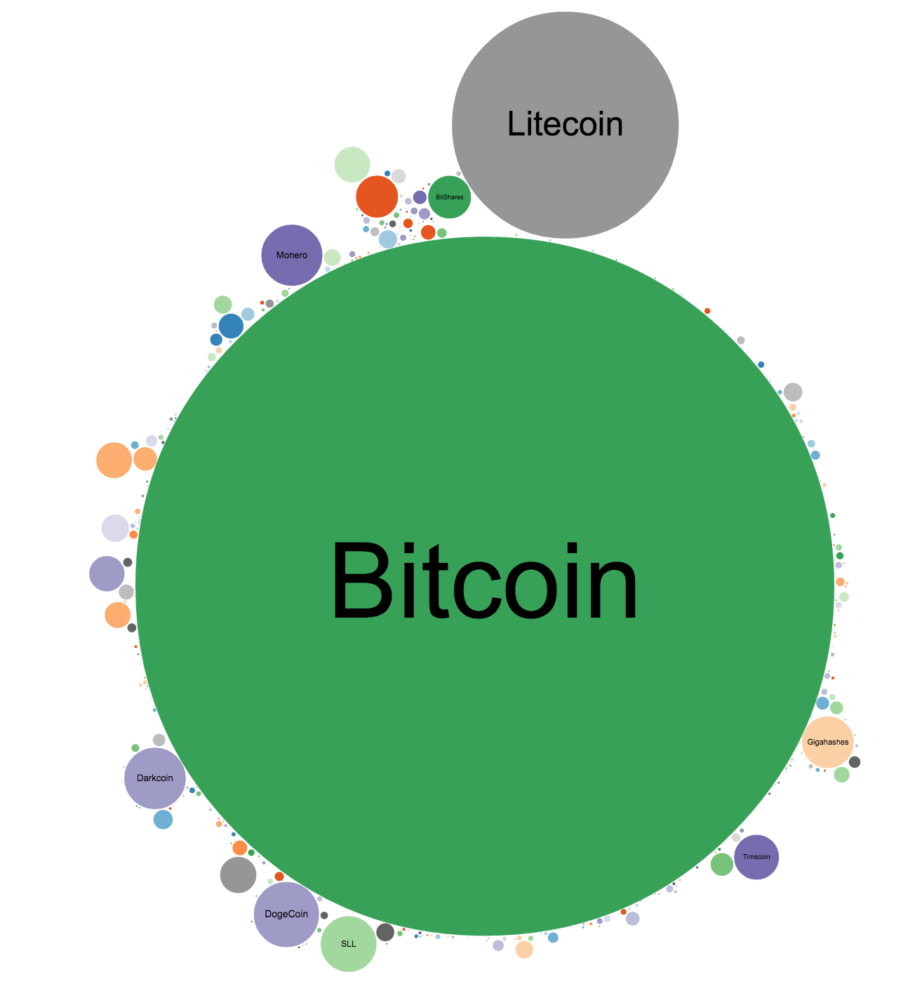
https://www.cryptocoincharts.info/coins/graphicalComparison
by trading volume (not market cap)

Slide 18
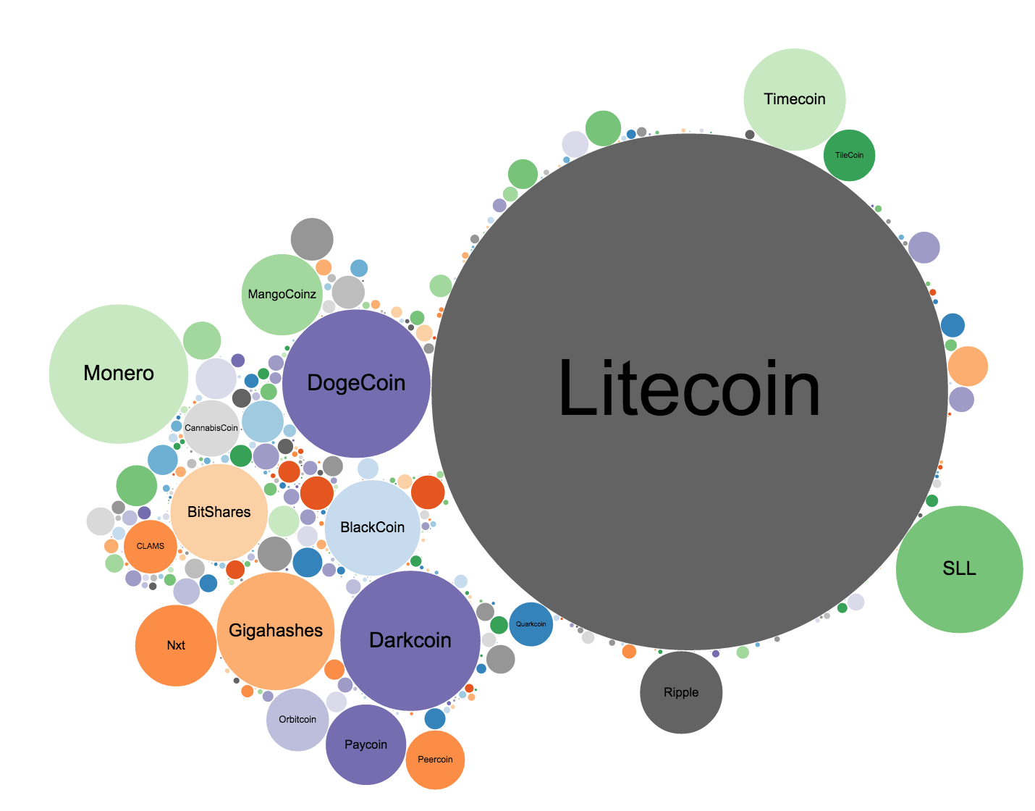
Ripple: last 24 hours,
volume 90 BTC

Slide 19
What is the Market Cap of PointCoin?

Slide 20
http://blockexplorer.bitcoin-class.org/
Block 3652 means there are 36520 PointCoins in existence.

Slide 21

http://blockexplorer.bitcoin-class.org/
Block 3652 means there are 36520 PointCoins in existence.
Market Cap:
36520 / 1629 =
22.42 pizzas delivered
= $450.
http://coinmarketcap.com/6

Slide 22
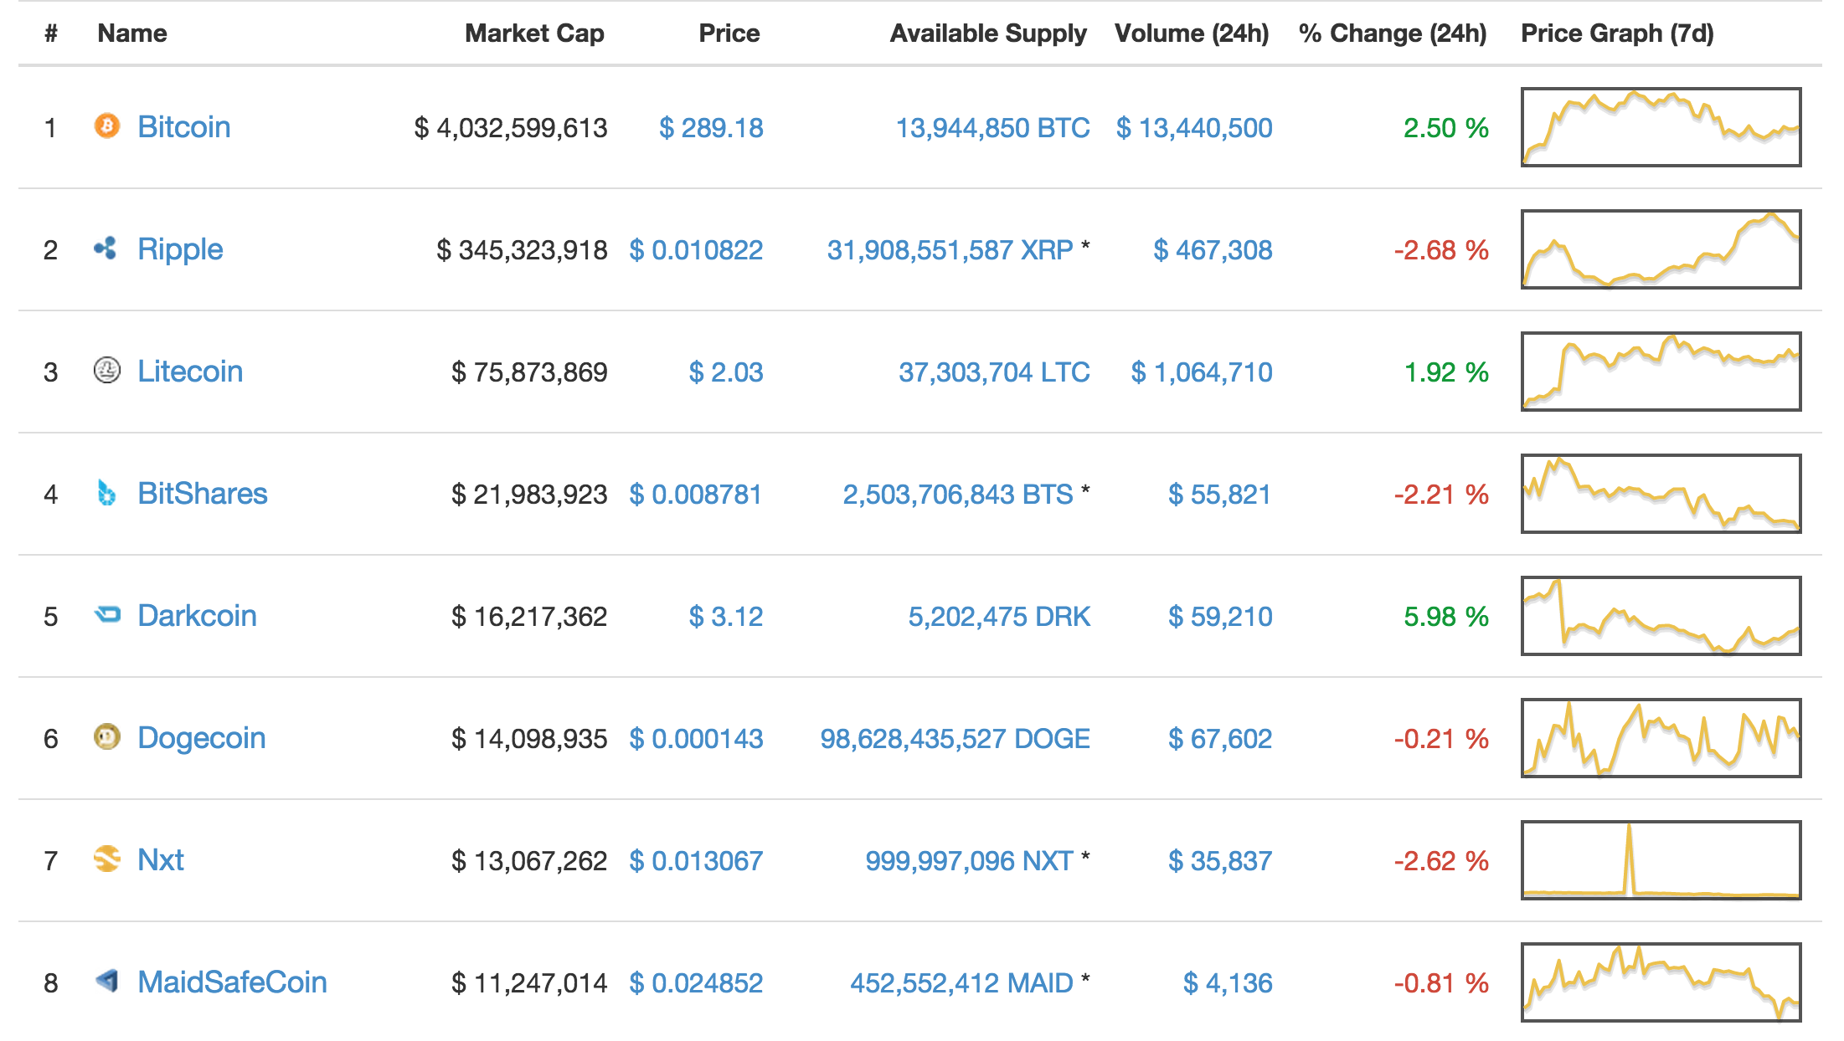
Example (“Uninteresting”) Altcoin

Slide 23




Slide 24
Dogecoin Design
Bitcoin [Jan 2009]
Target block time: 10 minutes
Proof-of-work: SHA256 double hash(BH) < difficulty
Supply: 21 million limit, mining subsidy halving
Litecoin [Oct 2011]
Target block time: 2.5 minutes
Proof-of-work: scrypt hash
Supply: 84 million limit, same way as BTC
Dogecoin [Dec 2013]
Target block time: 1 minute
Proof-of-work: scrypt hash
Supply: no limit, 100B + ~5B/year
(originally: random block reward!)

Slide 25
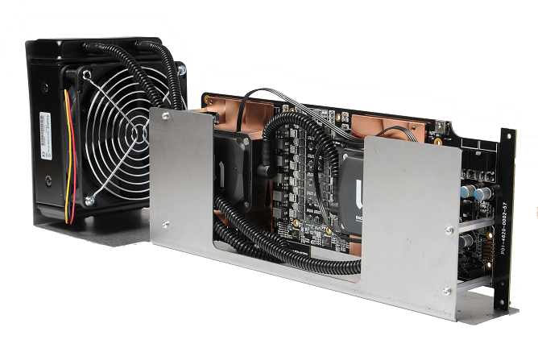
Use SHA-256 or a different hash?

Slide 26
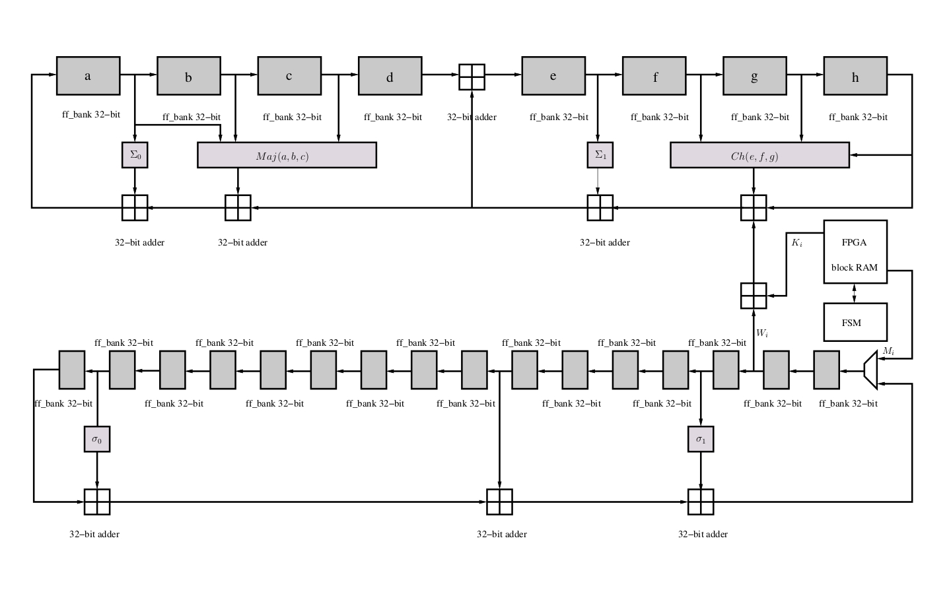
http://opencores.org/project,sha256core

Slide 27
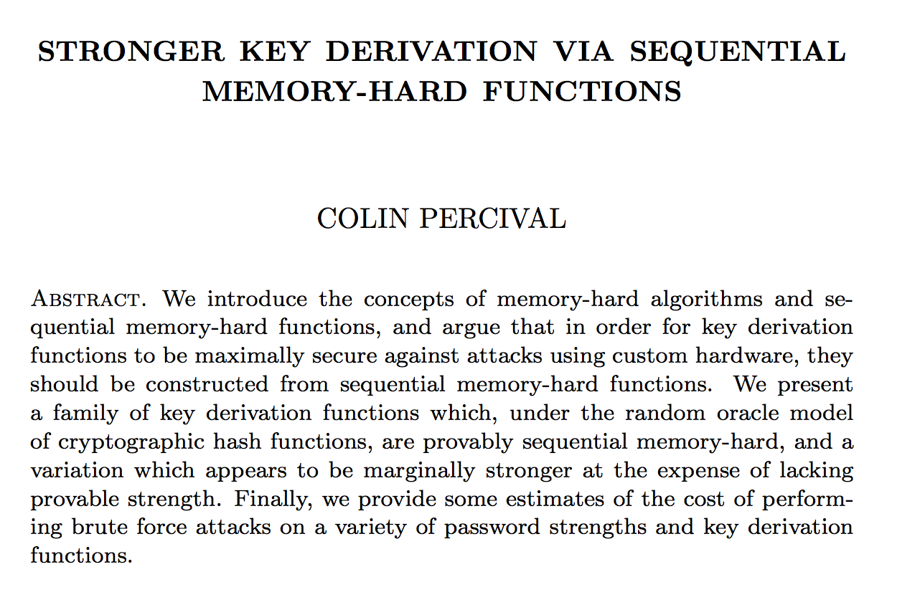
scrypt hash function [2009]

Slide 28
Key Derivation

Slide 29
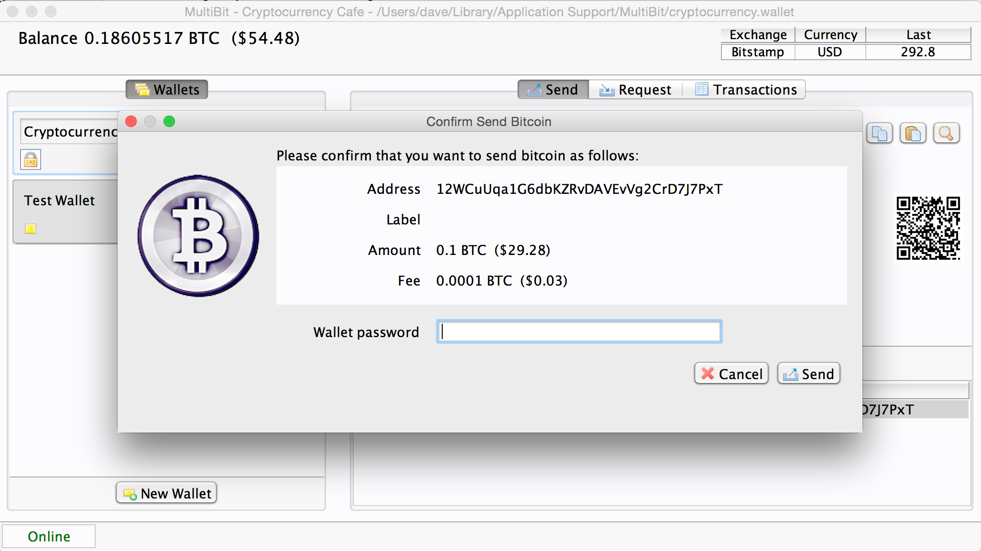

Slide 31
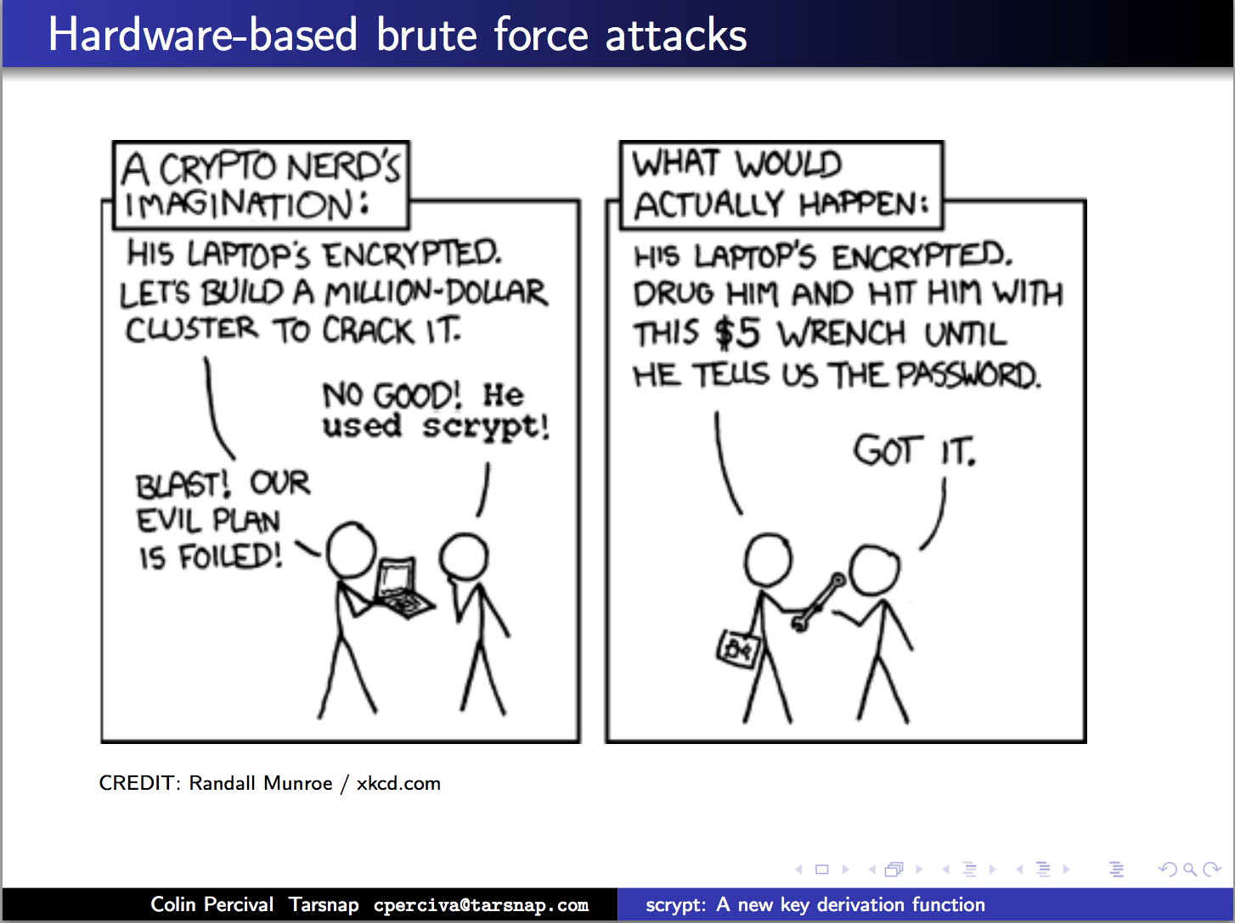

Slide 32

Memory-Hard Algorithm
(From Percival’s paper)

Slide 33
Simple Candidate
mh-hash(x):
prng = seed(x)
result = 0
for nrounds:
result = result XOR mem[prng.next()]
return result

Slide 35
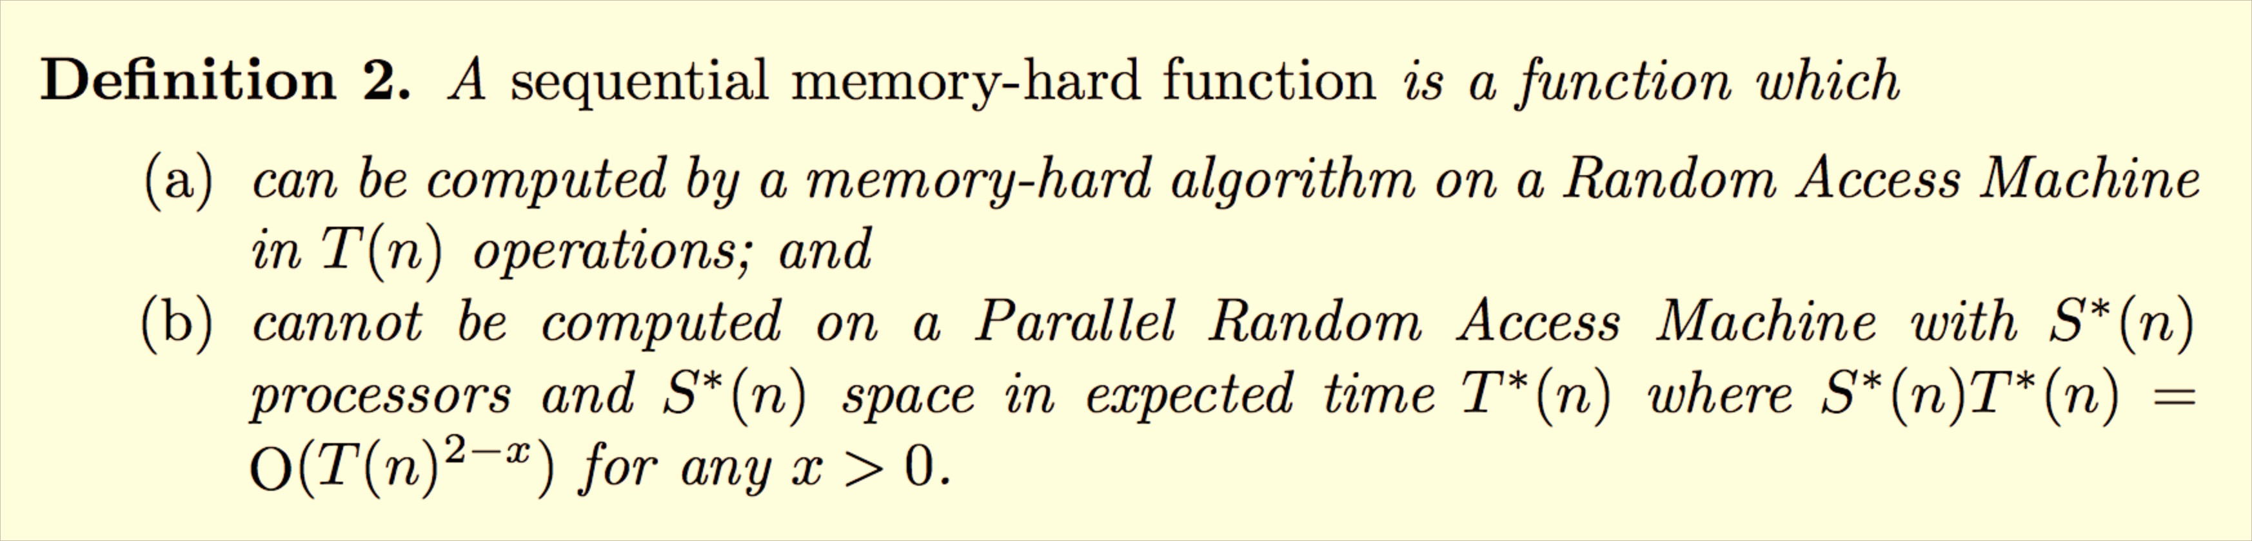
Sequential Memory-Hard Algorithm
(From Percival’s paper)

Slide 37
mh-hash(x):
prng = seed(x)
result = prng.next()
for nrounds:
result = result XOR mem[result] XOR prng.next()
return result

Slide 38
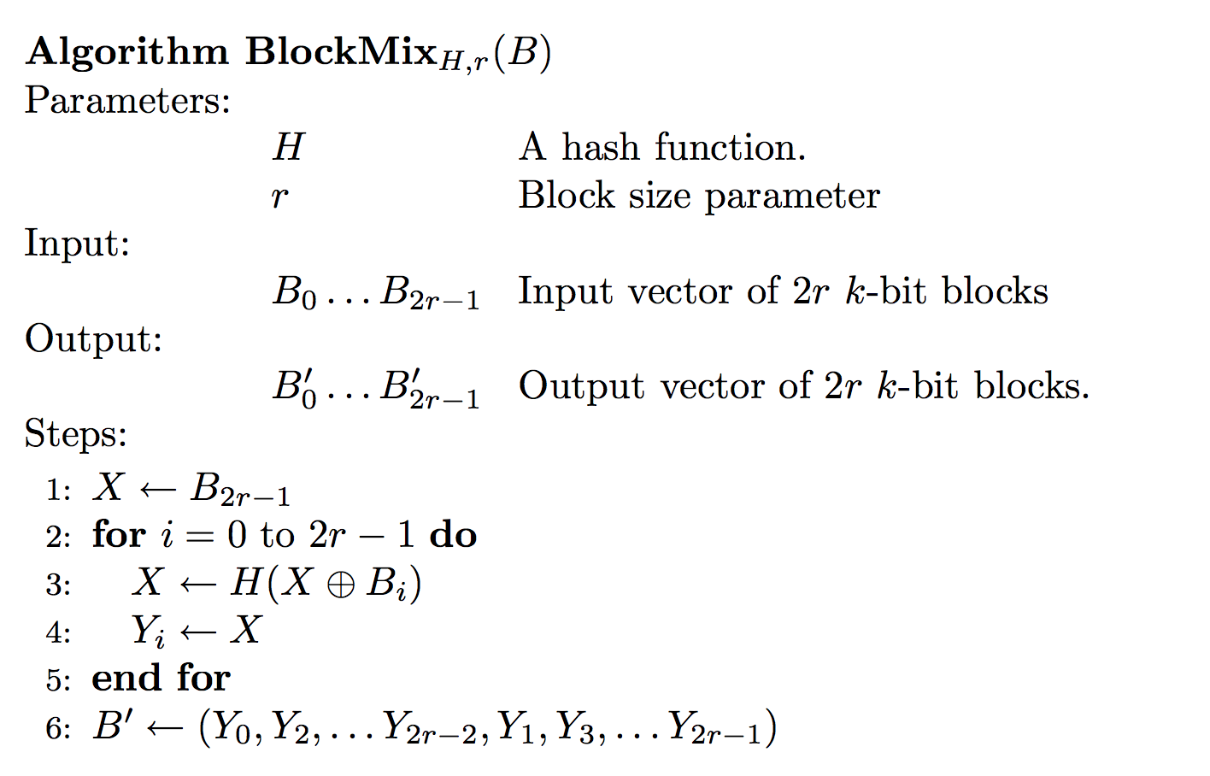

Slide 39
Litecoin Mining Hardware (?)
https://litecoin.info/Mining_hardware_comparison

Slide 40
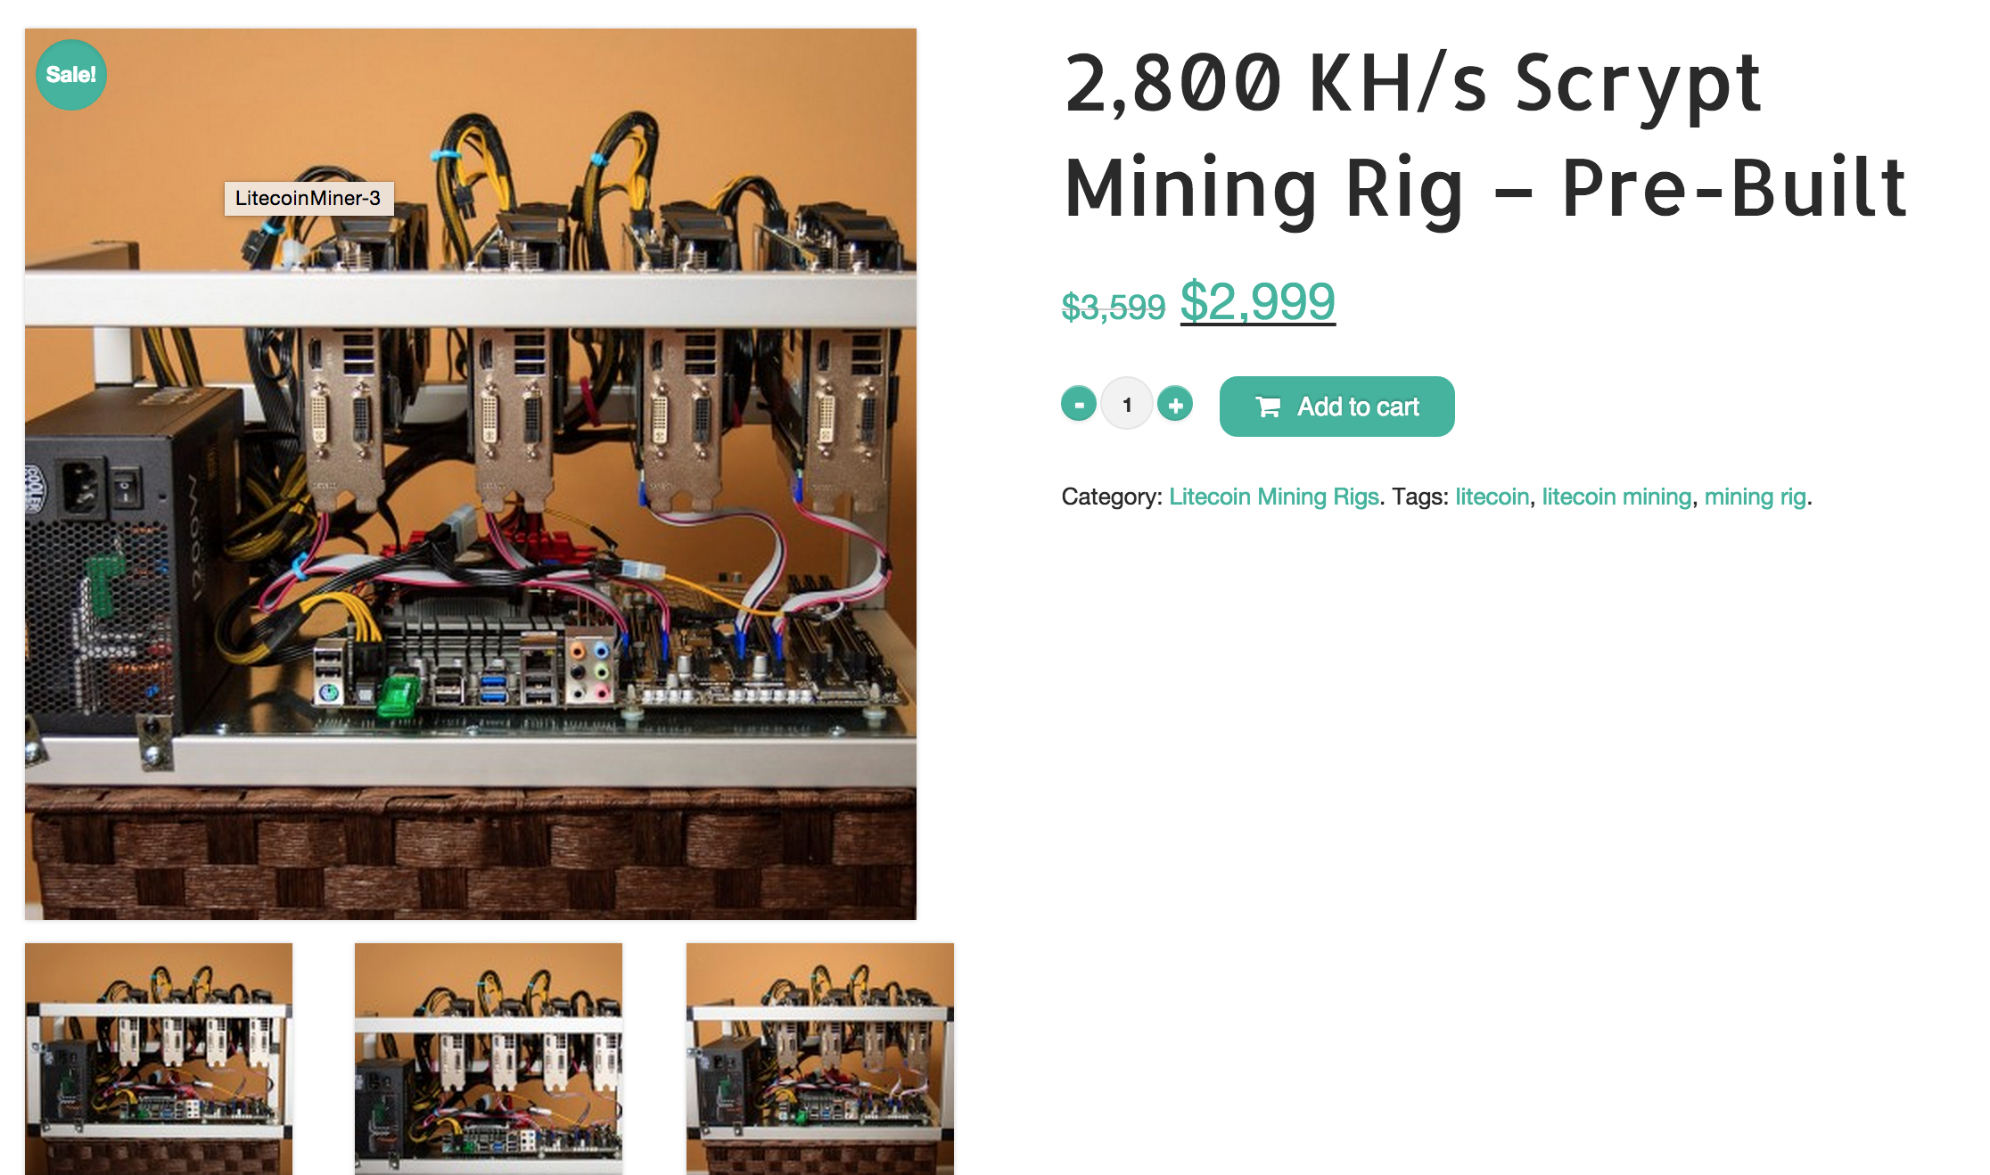
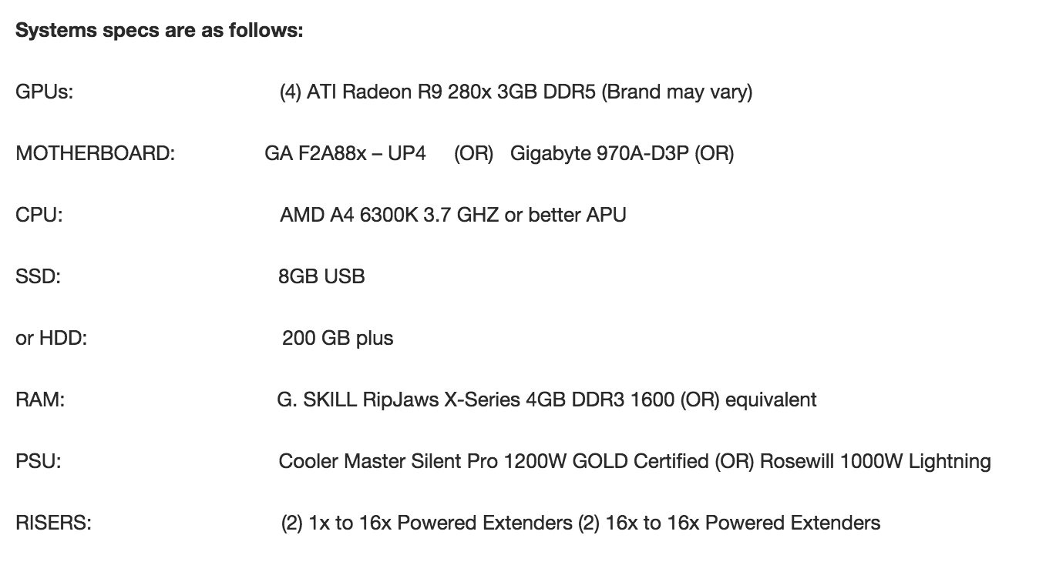

Slide 41


Slide 43
Proofs-of-Work
Bitcoin: SHA-256
Compute intensive
No value, motivates investment in SHA ASICs
Litecoin, Dogecoin: scrypt
Memory-access intensive
No value, motivates investment in general- purpose computing (?)
Can we have a proof-of-work that also produces something useful?

Slide 44


Challenge of Useful Proofs-of-Work
Need to embed previous block and transactions in problem
Need random problem instances to be useful
Need partially-selected problem instances to be hard
Must be easy to verify winning results
Want adjustable difficulty

Slide 45
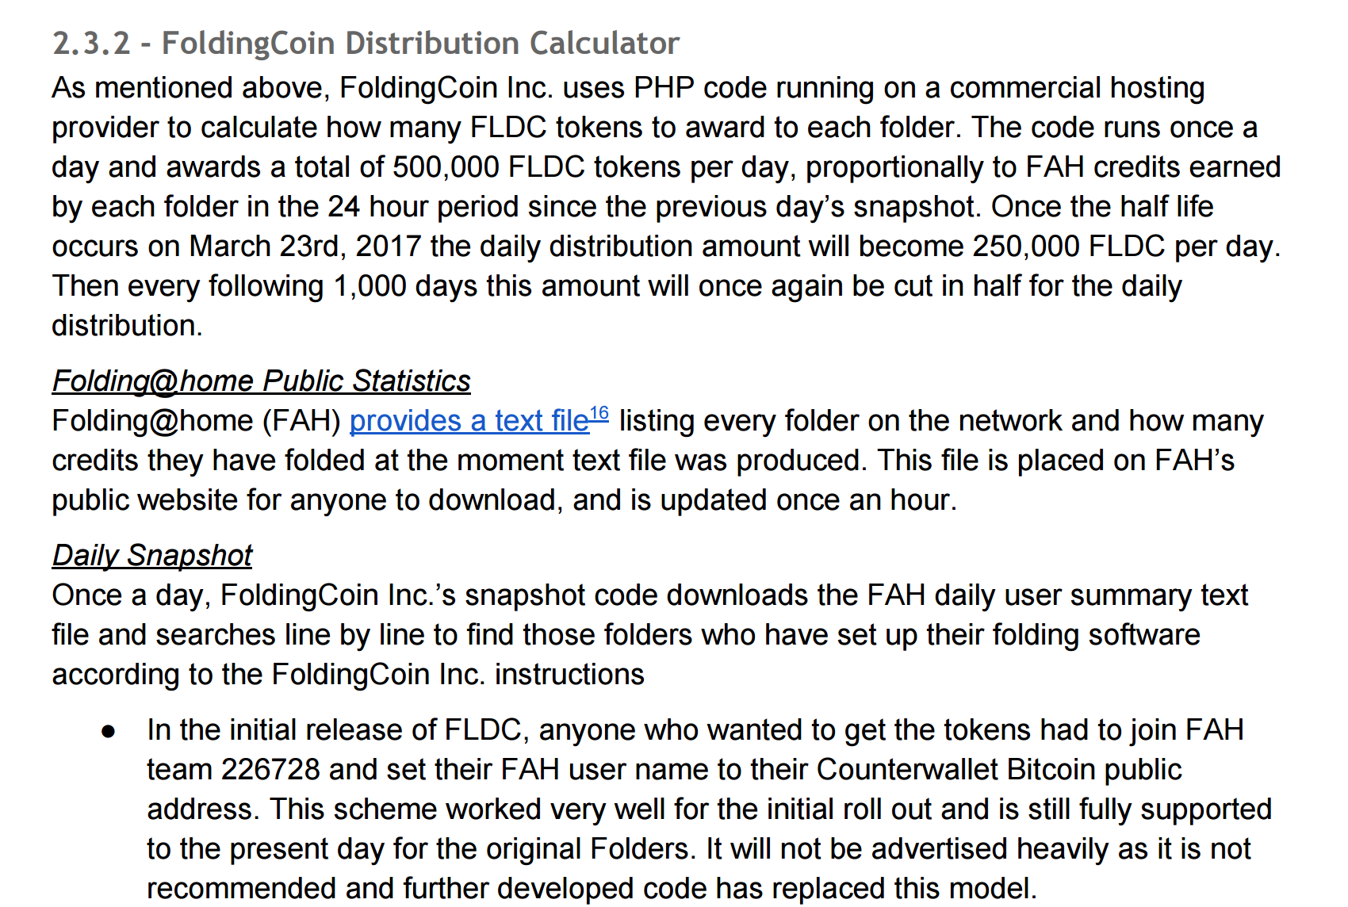
http://foldingcoin.net/wp/wp-content/uploads/2015/02/FoldingCoin-White-Paper-v1.0.pdf

Slide 46
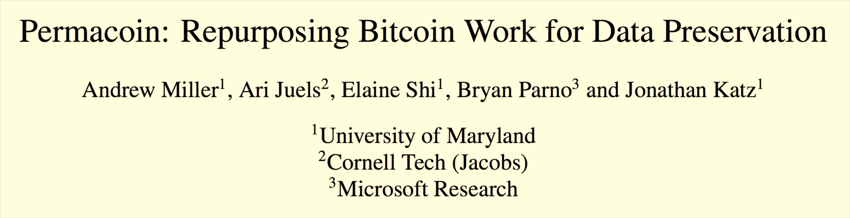
IEEE Security and Privacy (“Oakland”), 2014
Proof-of-Retrievability: node is storing what it should
Ensure local storage: block access depend on private key, which is also owner of coin value.

Slide 47
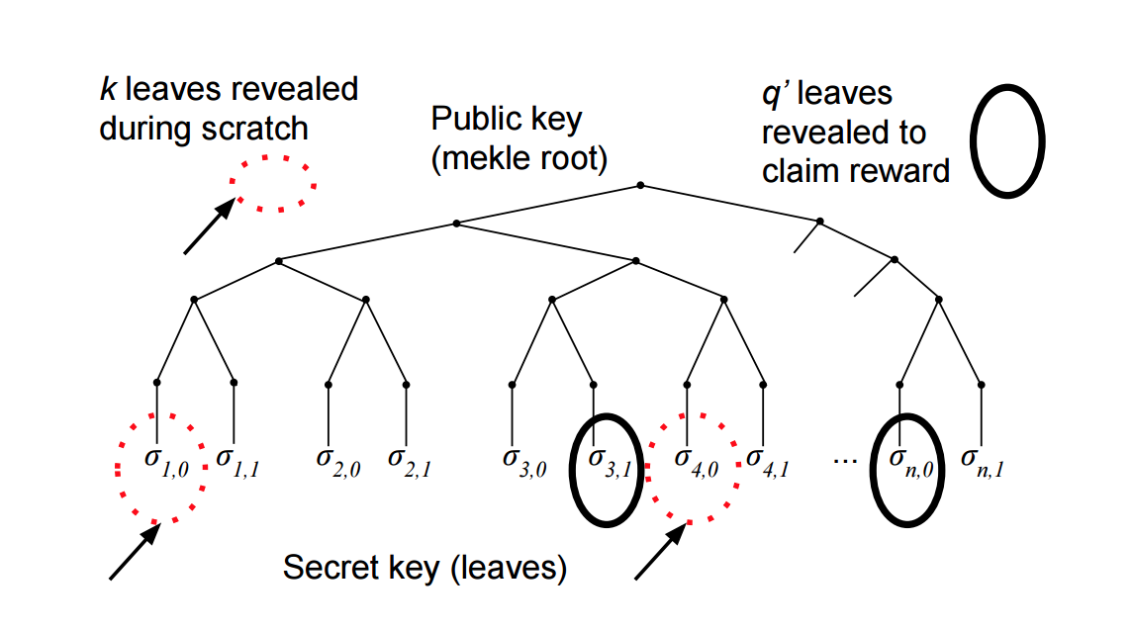
Permacoin: Merkle Tree

Slide 48
Bitcoin-like decentralized currencies:
it is about the community!

Slide 49
Charge
Project Proposals due Thursday (11:59pm)
If you don’t already have an idea or are looking for teammates, come to office hours! (right now)

